Slide 1
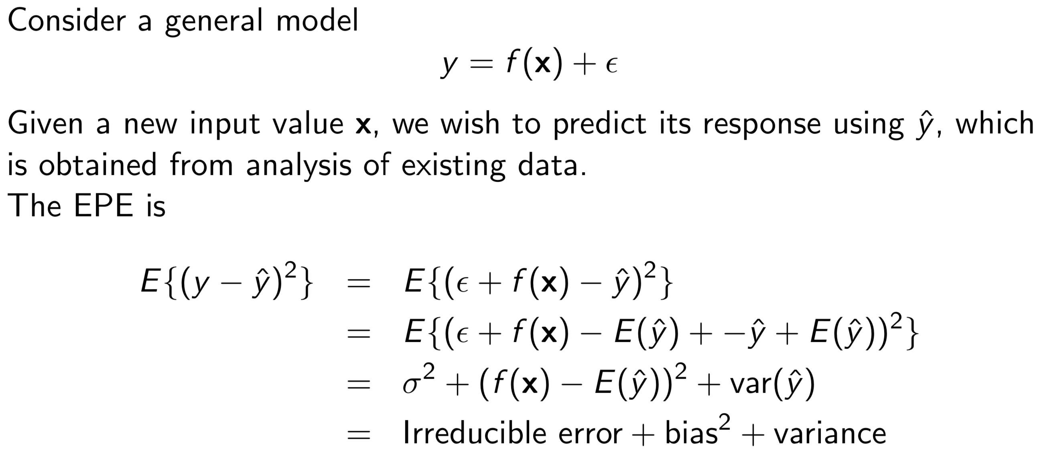
MSDM 5054
Dr. Dong XIA
3.6 More About Predictions
Expected prediction error (EPE)
1
Chapter 3. Linear Regression

Slide 2
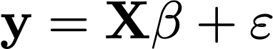
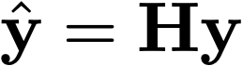

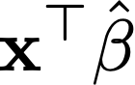
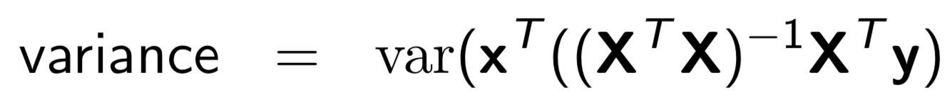
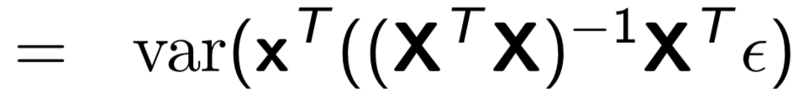
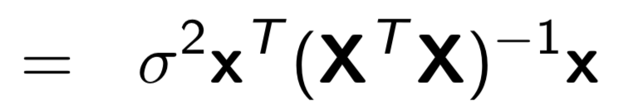
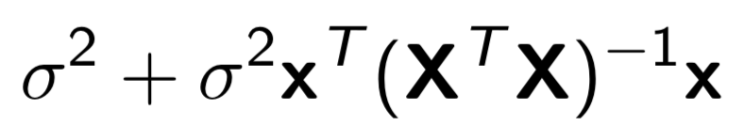
MSDM 5054
Dr. Dong XIA
3.6 More About Predictions
EPE of linear regression
Linear model
LSE
Bias
It means that LSE is unbiased estimator for linear regression model.
Variance of estimating
2
Chapter 3. Linear Regression

Slide 3
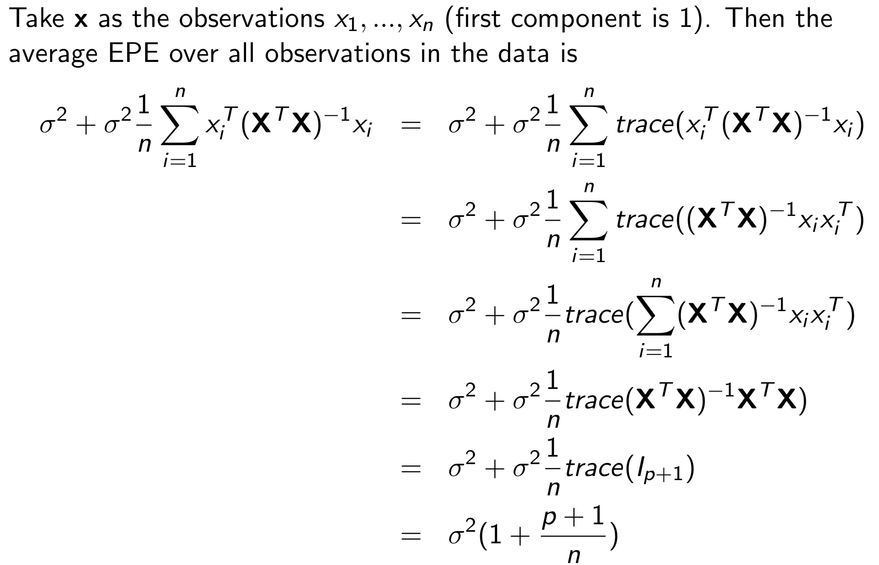
MSDM 5054
Dr. Dong XIA
3.6 More About Predictions
Average EPE of linear regression
3
Chapter 3. Linear Regression

Slide 4
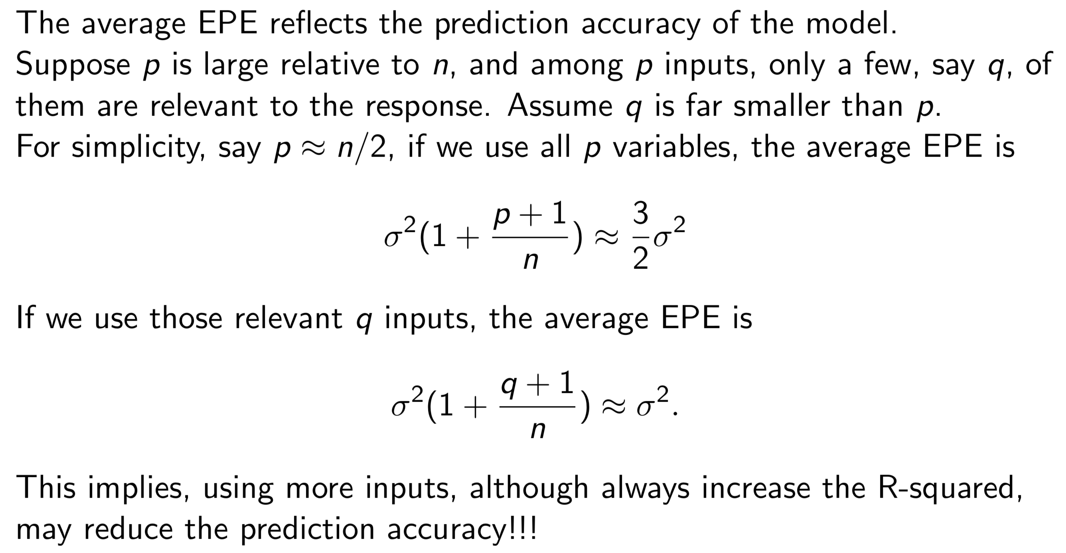
MSDM 5054
Dr. Dong XIA
3.6 More About Predictions
Average EPE of linear regression
4
Chapter 3. Linear Regression

Slide 5
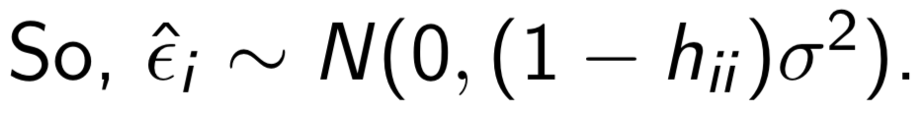
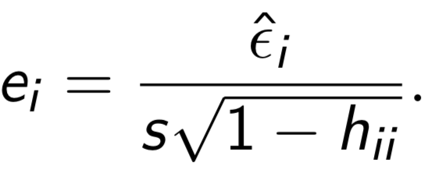
MSDM 5054
Dr. Dong XIA
3.8 Assessing the Regression Model
a) Error distribution (normality check)
Adjusted residuals
Training error is one of the measurement of the quality of fit.
An (internally) studentized residual is
A more appropriate one is the (externally) studentized residual which uses
an s from the least squares fitting by deleting the i-th observation.
5
Chapter 3. Linear Regression

Slide 6
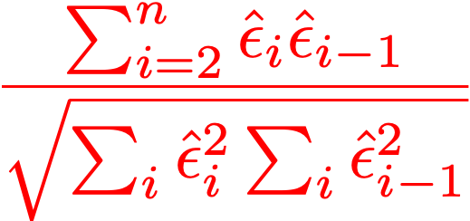
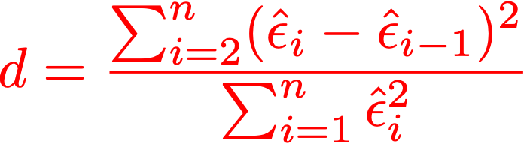
MSDM 5054
Dr. Dong XIA
3.8 Assessing the Regression Model
c) Error dependence
The error dependence cause the inference to be incorrect.
Use autocorrelation of the residuals (ACF) to check the independence
assumption of the errors.
One can also use Durbin-Watson test, which tests whether the first few
autocorrelations are 0.
6
Chapter 3. Linear Regression

Slide 7

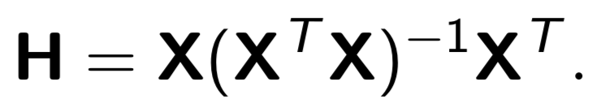
MSDM 5054
Dr. Dong XIA
3.8 Assessing the Regression Model
d) Leverage and Cook’s D
7
Chapter 3. Linear Regression

Slide 8
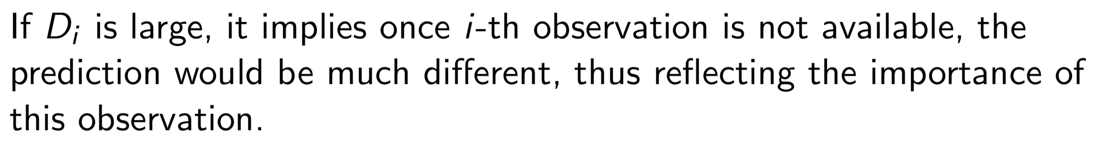
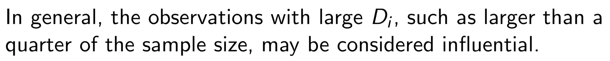
MSDM 5054
Dr. Dong XIA
3.8 Assessing the Regression Model
d) Leverage and Cook’s D
8
Chapter 3. Linear Regression

Slide 9
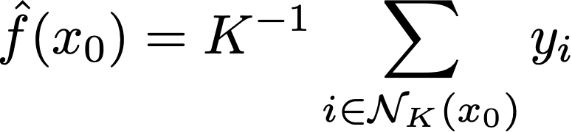
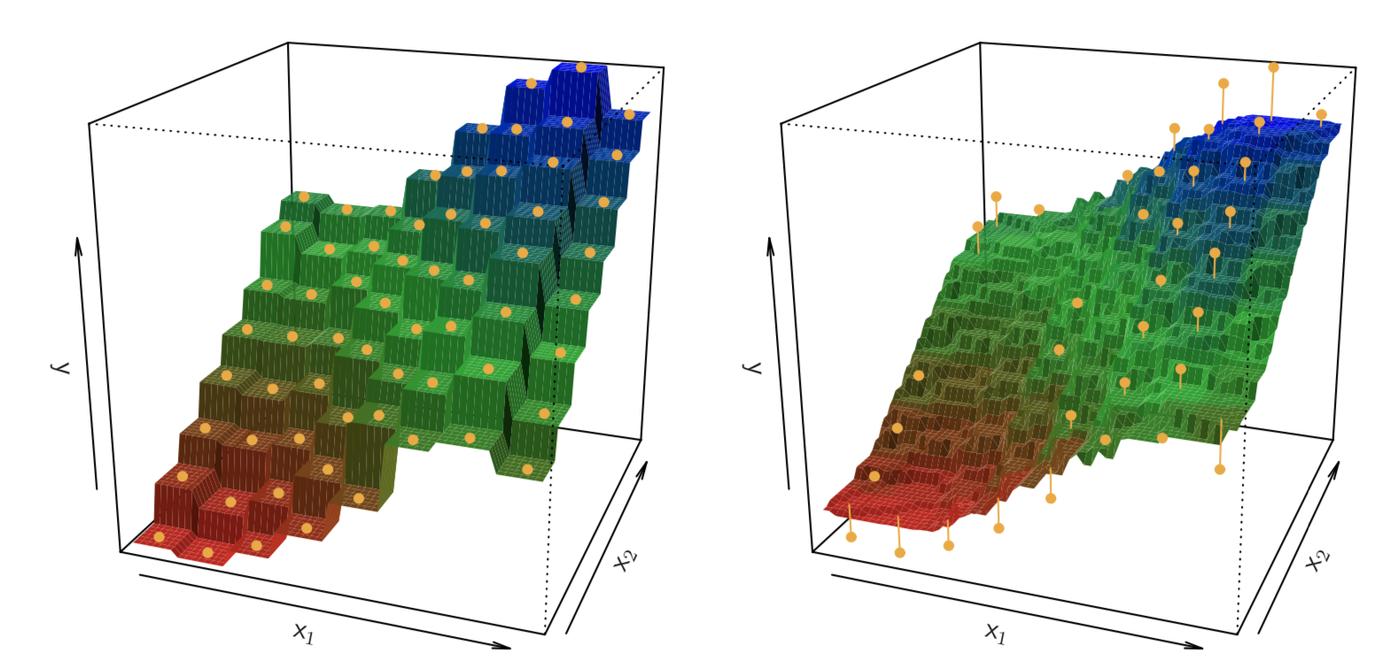
MSDM 5054
Dr. Dong XIA
3.10 Comparison with KNN Regression
KNN regression
Example 1
The KNN regression on a two-dimensional data set with 64 observations
(orange dots). Left: K = 1 results in a rough step function fit. Right: K = 9
produces a much smoother fit.
9
Chapter 3. Linear Regression

Slide 10
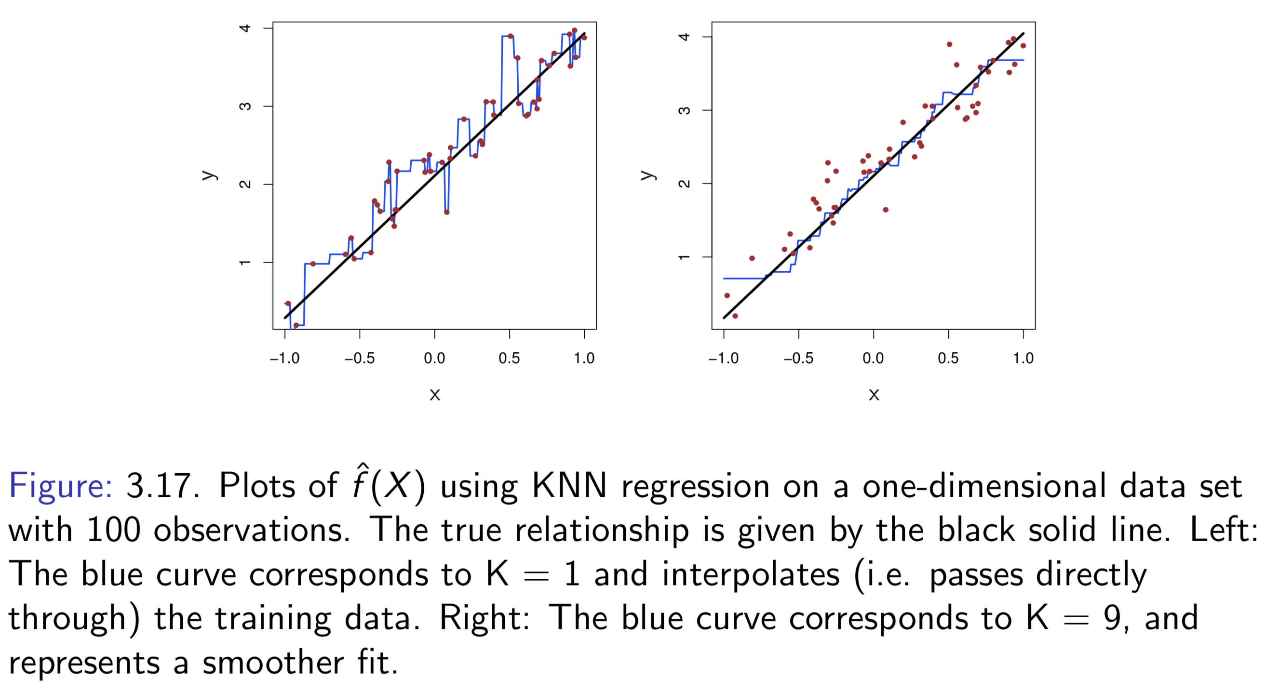
MSDM 5054
Dr. Dong XIA
3.10 Comparison with KNN Regression
Example 2
10
Chapter 3. Linear Regression

Slide 11
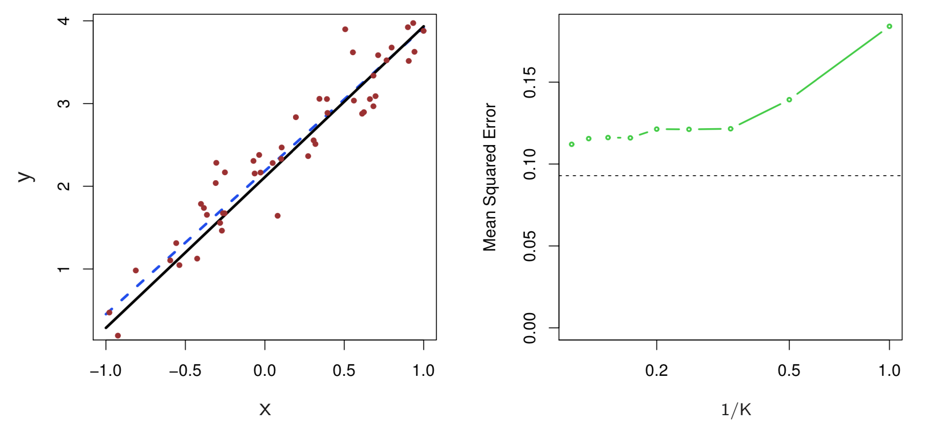
MSDM 5054
Dr. Dong XIA
3.10 Comparison with KNN Regression
Example 3
Details on next slide
11
Chapter 3. Linear Regression

Slide 12
MSDM 5054
Dr. Dong XIA
3.10 Comparison with KNN Regression
Example 3 (cont.)
The same data set shown in Example 2 is investigated further.
Left: The blue dashed line is the least squares fit to the data. Since f (X ) is in fact
linear (displayed as the black line), the least squares regression line provides a very
good estimate of f(X).
Right: The dashed horizontal line represents the least squares test set MSE, while
the green solid line corresponds to the MSE for KNN as a function of 1/K (on the
log scale). Linear regression achieves a lower test MSE than does KNN regression,
since f (X ) is in fact linear. For KNN regression, the best results occur with a very
large value of K, corresponding to a small value of 1/K.
12
Chapter 3. Linear Regression

Slide 13
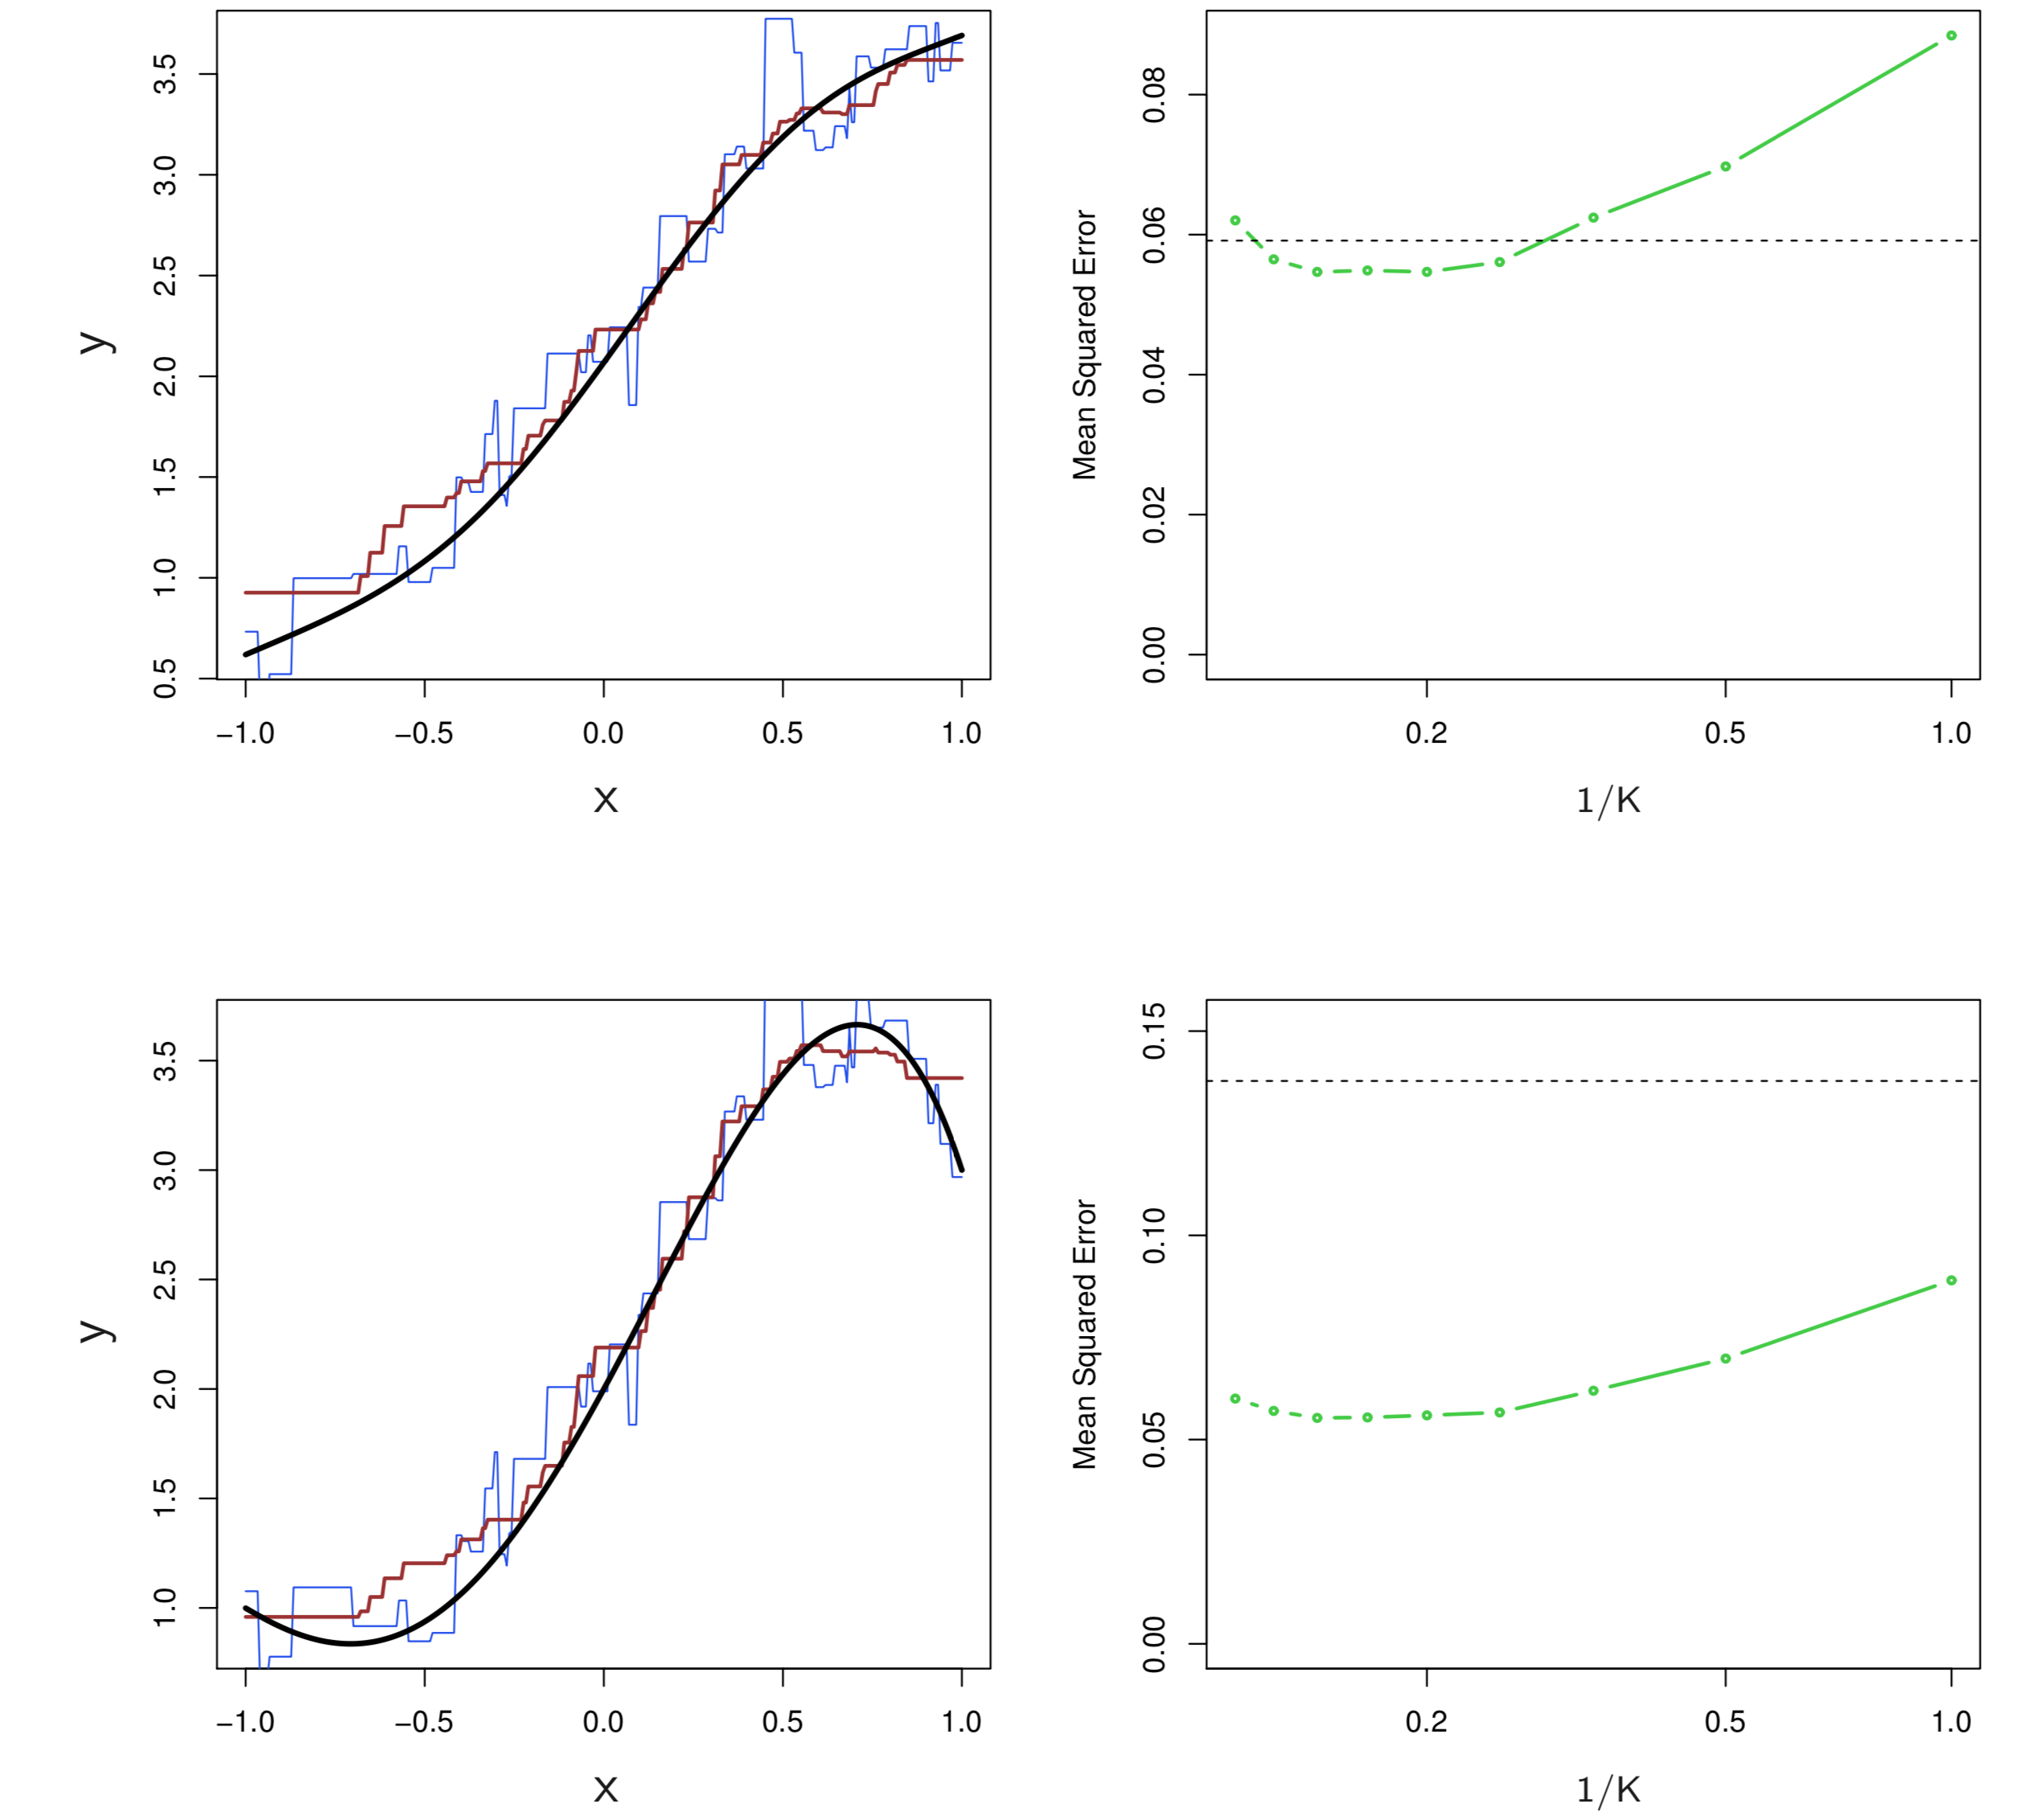
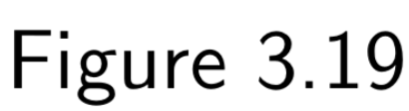
MSDM 5054
Dr. Dong XIA
3.10 Comparison with KNN Regression
Example 4
Details on next slide
13
Chapter 3. Linear Regression

Slide 14
MSDM 5054
Dr. Dong XIA
3.10 Comparison with KNN Regression
Example 4 (cont.)
Top Left: In a setting with a slightly non-linear relationship between X and Y
(solid black line), the KNN fits with K = 1 (blue) and K = 9 (red) are displayed.
Top Right: For the slightly non-linear data, the test set MSE for least squares
regression (horizontal black) and KNN with various values of 1/K (green) are
displayed.
The Bottom Left and Bottom Right: As in the top panel, but with a strongly
non-linear relationship between X and Y .
14
Chapter 3. Linear Regression

Slide 15
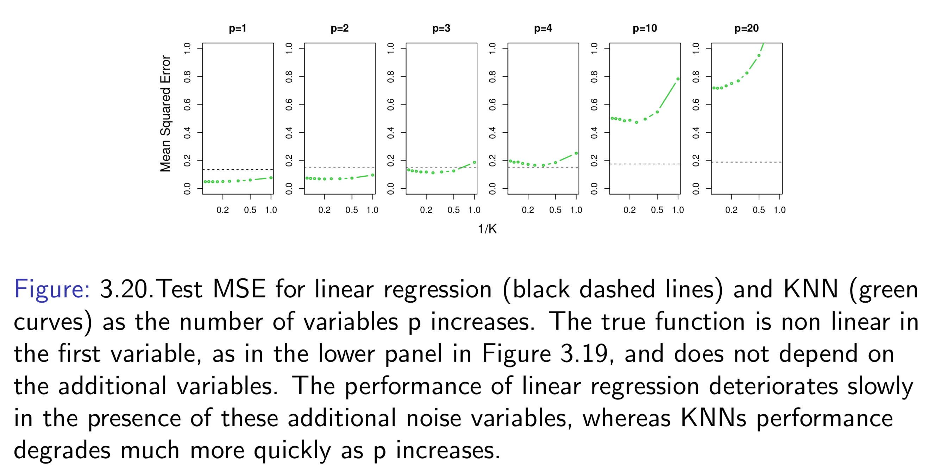
MSDM 5054
Dr. Dong XIA
3.10 Comparison with KNN Regression
Example 5
15
Chapter 3. Linear Regression

